Slide 1
© 2016 Blackboard Inc.
All rights reserved.

Slide 2
Objectives
Learn about the different types of content you can add to your course.
Add items and tools to content areas.
Explore the content editor and Course Files.
Learn about three common ways to add files to your course.
Help your students feel at ease in the online environment.

Slide 3
Contact Info
Add here or delete slide
Add here

Slide 4
ADDING items and tools

Slide 5
Types of content
Discuss the types of content you can add using the functions on the action bar.

Slide 6
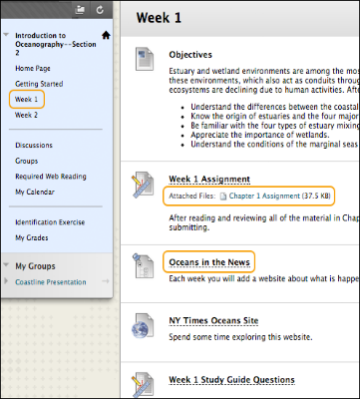
IN action

Slide 7
The basic process
Add a content area.
Access the content area from the course menu. Be sure Edit Mode is ON to access all the instructor's functions.
Add materials and tools to the content area.
Organize your content areas by editing the links to materials and tools, and creating folders.
Notes:
In this workshop, you will learn to add materials and tools to content areas. You will share documents and files with students by adding items, and then create links to Blackboard Learn tools.

Slide 8
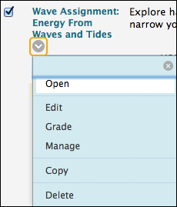
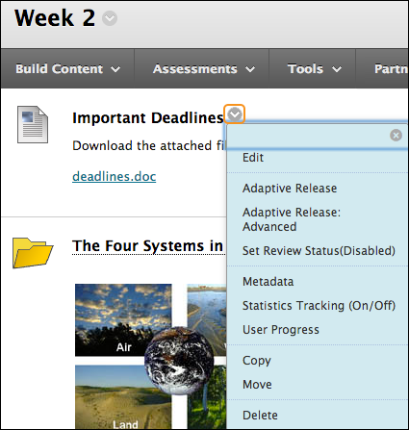
CONTEXTUAL MENUS

Slide 9
EDIT MODE
Notes:
Click Edit Mode to change from ON to OFF. When Edit Mode is ON, all instructor functions are available. When Edit Mode is OFF, the instructor functions are hidden.
For example, when Edit Mode is ON, the course menu’s Add Menu Item function is available, which is shown as a plus sign. Use this function to add links to the course menu. Students do not see this function.

Slide 10
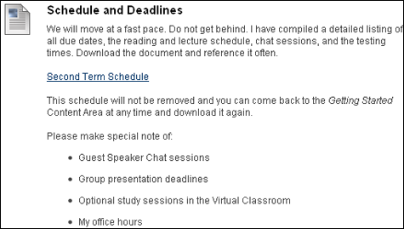
CONTENT ITEMS

Slide 11
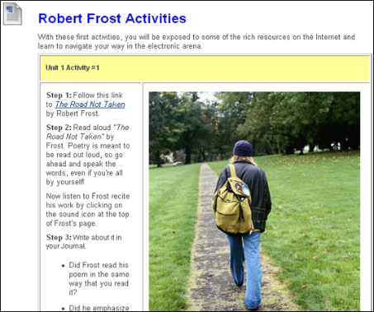
THE content editor

Slide 12
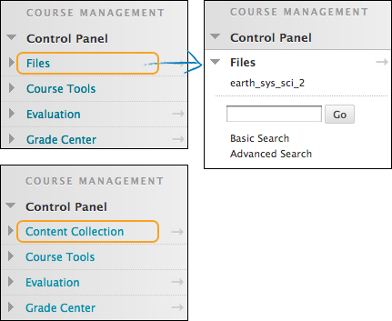
COURSE files

Slide 13
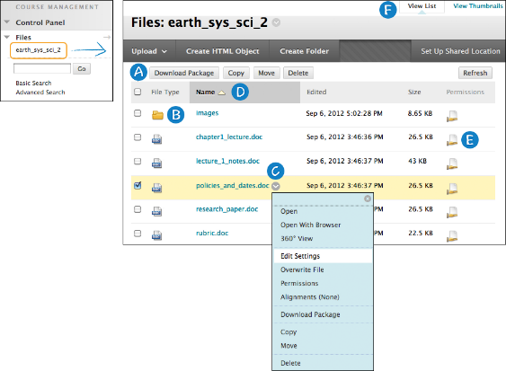
COURSE files features
Notes:
Perform an action on one file or multiple files and folders at one time. Select an item's check box and select a function on the contextual menu, such as Download Package, Copy, Move, or Delete.
Click a folder's name to view its contents.
Access an item's contextual menu and select an option, such as Edit, Copy, Move, or Delete.
Sort a column by clicking the column title or the caret.
In the Permissions column, click the icon to view and change who can see, edit, delete, and manage a file or folder.
Switch from View List—the default view—to View Thumbnails.

Slide 14
BEST PRACTICE
Three Common Ways to Add Files
To control where a file link appears, use the content editor to attach a file as you create content.
When creating content, attach a file in the Attachments section.
Add your files to Course Files or the Content Collection BEFORE you create content.

Slide 15
FREQUENTLY ASKED QUESTIONS
Before I create content, do I have to upload all my files into Course Files or the Content Collection?
What happens if I want to move a file from one content item to another?
Can I link to a file more than once?
If I do link to a file more than once, is there an easy way to keep track of where the links are in my course?

Slide 16
TRY IT
Use your Practice Course to add an item and tool link, and attach files.

Slide 17
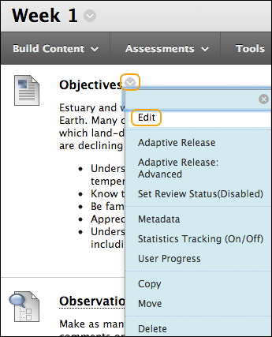
Manage itemS

Slide 18
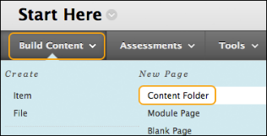
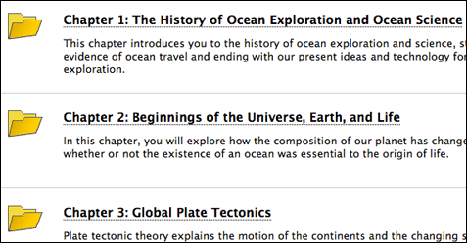
Organize with folders

Slide 19
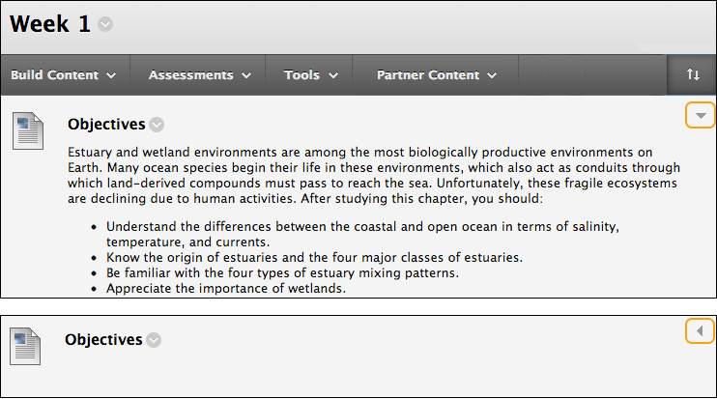
Hide and show details

Slide 20
FREQUENTLY ASKED QUESTIONS
If I can add a tool directly to the course menu, why might I add it to a content area?
What kind of files can I present to students by using content area items?

Slide 21
TRY IT
Use your Practice Course to organize your content items.

Slide 22
WRAP UP
To learn more, visit help.blackboard.com.

